Slide 1
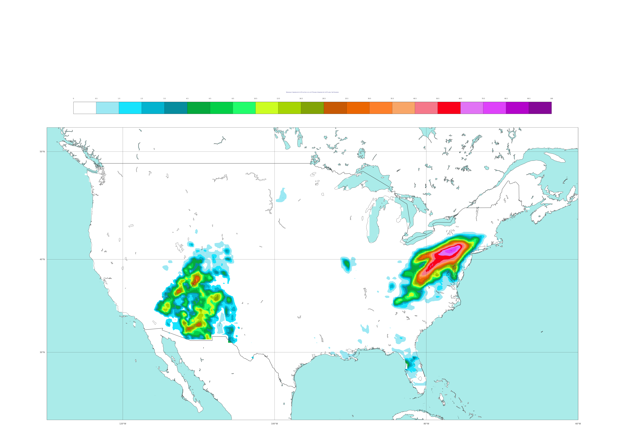
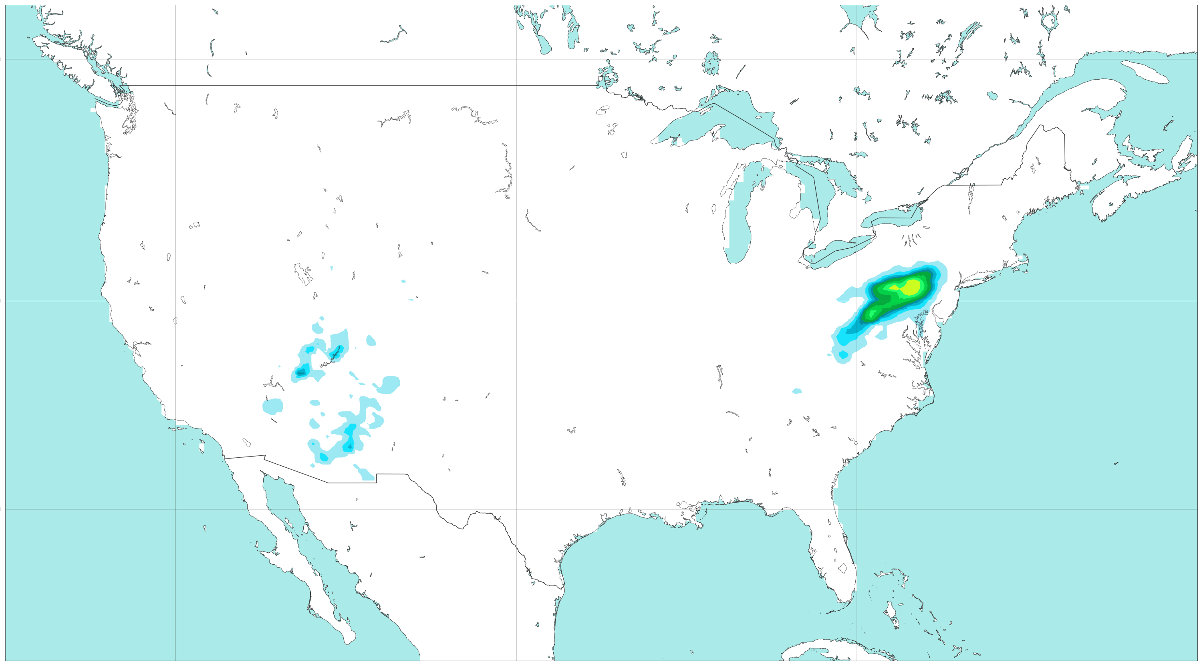




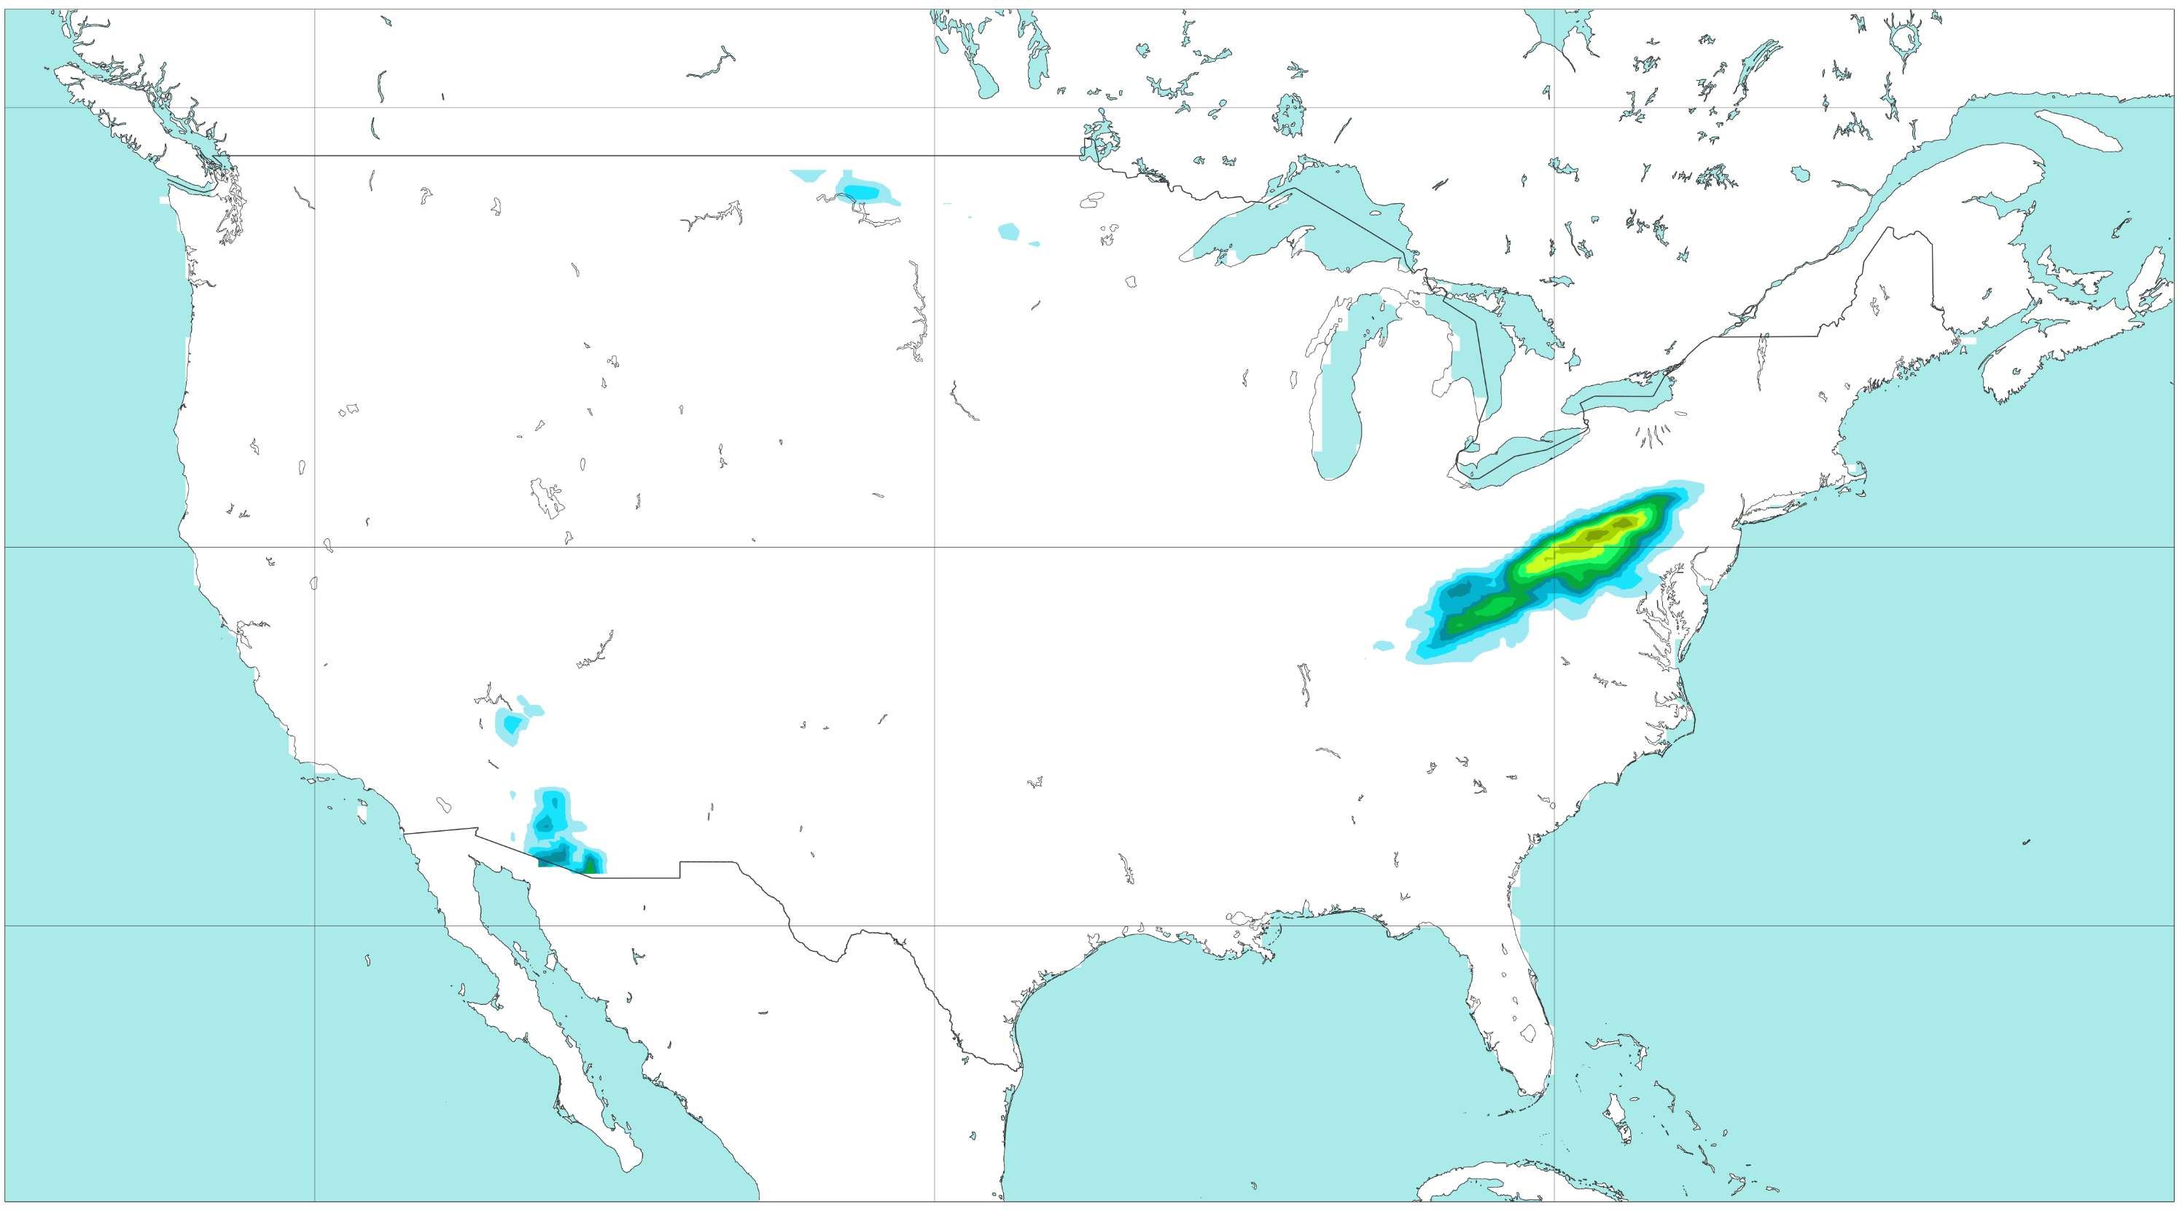
Feature variables for data-driven model
Probability of rainfall exceeding the 50-year return period (ERA5-ecPoint)
(VT: 2021-09-02 at 00 UTC)
[%]
0
0.5
1.5
2.5
3.5
4.5
6.5
8.5
10.5
13.5
16.5
20.5
25.5
30.5
35.5
40.5
50.5
60.5
70.5
80.5
90.5
100
a) Reanalysis
b) Forecasts: 2021-09-01 - 00 UTC (t+0,t+24)
50 °N
Small Convective System
Large-scale
System
40 °N
30 °N
c) Forecasts: 2021-08-31 - 00 UTC (t+24,t+48)
d) Forecasts: 2021-08-30 - 00 UTC (t+48,t+72)
50 °N
40 °N
30 °N
e) Forecasts: 2021-08-29 - 00 UTC (t72,t+96)
f) Forecasts: 2021-08-28 - 00 UTC (t+96,t+120)
50 °N
40 °N
30 °N
120 °W
100 °W
80 °W
120 °W
100 °W
80 °W

